Slide 1
Cardiff
the capital of wales

Slide 2
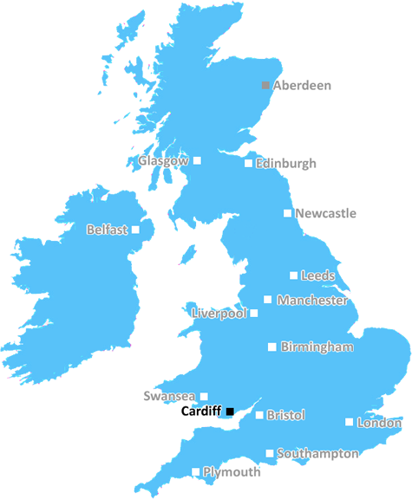
Cardiff location.ೃ࿐
╰┈➤ Cardiff, city and capital of Wales.
Cardiff exists as both a city and a county within the
Welsh unitary authority system of local government.
It is located within the historic county of Glamorgan
(Morgannwg) on the Bristol Channel at the mouth of
the River Taff, about 150 miles (240 km) west of
London.
Area -140,3 km²
Population- 369 202 (2017)

Slide 3
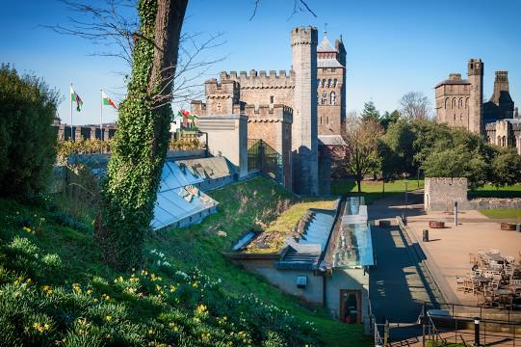
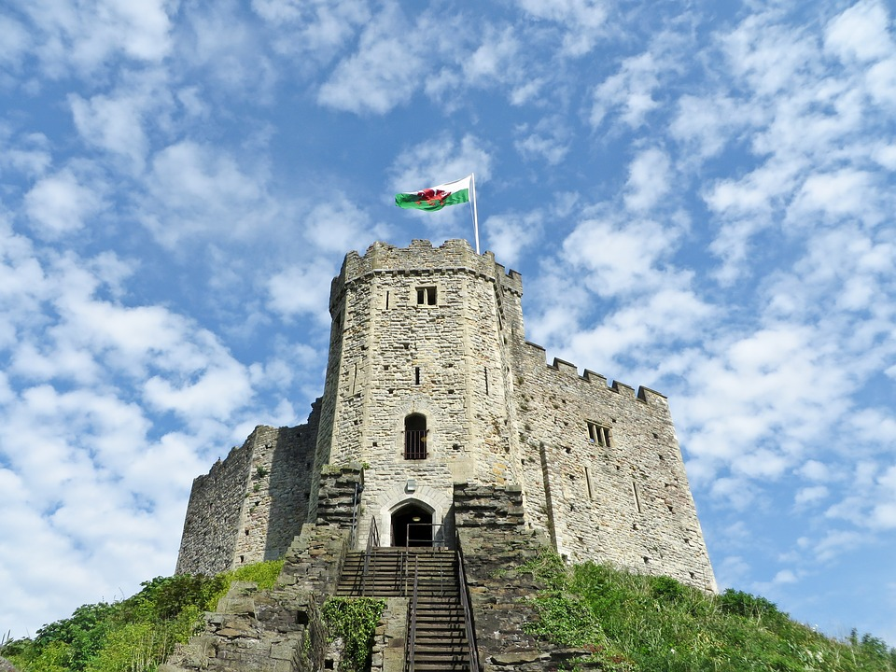
Cardiff Castle ྀ࿐ ˊˎ-
╰┈➤ Cardiff castle is one of the most popular tourist attractions in Wales. ╰┈➤It has 2000 years of history and was the home of a Roman fort and royal families.

Slide 4
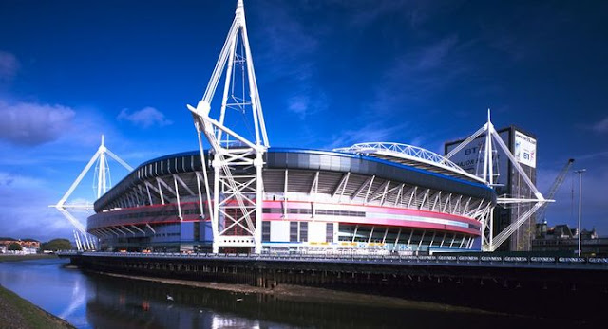
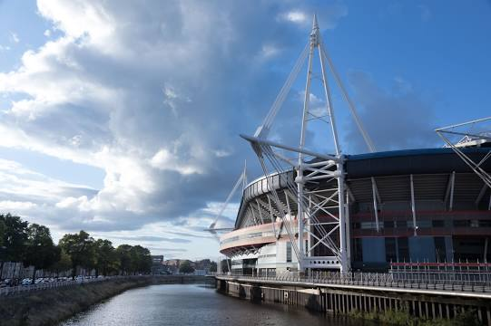
Millennium Stadiumೄྀ࿐ ˊˎ-
—-----------------------------------------------
╰┈➤ Millennium Stadium is the National Stadium of Wales.
╰┈➤ Actually it is the largest football ground in the whole uk with being capable to lest around 75.000 people to watch the game.
—--------------------------------------------

Slide 5
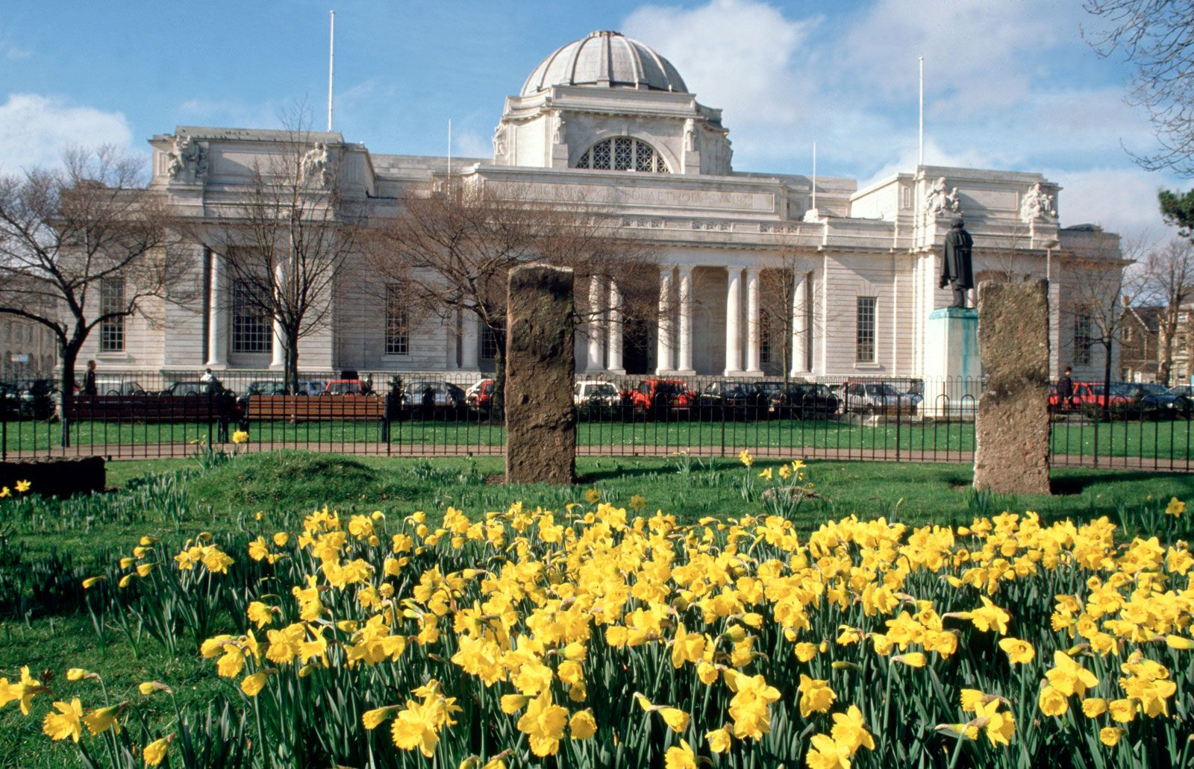
Amgueddfa Cymruೄྀ࿐ ˊˎ-
Museum Wales, is a Welsh Government sponsored body that comprises seven museums in Wales:
-National Museum Cardiff
-St Fagans National Museum of History, Cardiff
-Big Pit National Coal Museum, Blaenavon
-National Wool Museum, Dre-fach Felindre
-Llandysul
-National Slate Museum, Llanberis
-National Roman Legion Museum, Caerleon
-National Waterfront Museum, Swansea

Slide 6
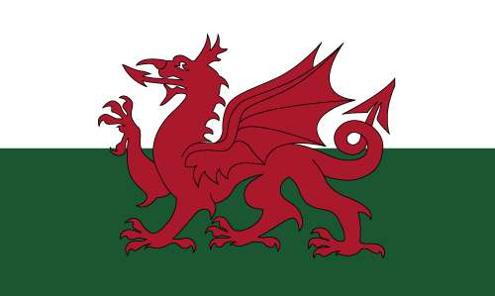
Flag of Wales.ೃ࿐
—----------------------------------------------------
The meaning of the Welsh flag is thus: The white half stands for peace and honesty, the green half stands for joy and hope, and the red dragon signifies valor and bravery. Like the flag of Scotland, but unlike the flag of England, the Welsh national flag is an official national flag passed by the Welsh government.
—-----------------------------------------------------

Slide 7
interesting facts about wales and cardiff
Since December 20, 1955, Cardiff has been the capital of Wales.
The funny thing is that there are four times as many sheep as people in Wales.
There are some very interesting place names in Wales. The most famous is Llanfairpwllgwyngyllgogerychwyrndrobwyll-llantysiliogogogoch. In free translation, it means "St. Mary's Church by the pond among the white hazel trees near the watery whirlpool below the Red Cavern at St. Tysilia's Church."
In the Middle Ages, there was a law allowing divorce when a spouse or spouses had bad breath. This provision was never removed from Welsh law.
Walia, mimo że nie jest dużym krajem, posiada ponad 500 zamków i twierdz, co stawia ją w czołówce światowej.

