Slide 1
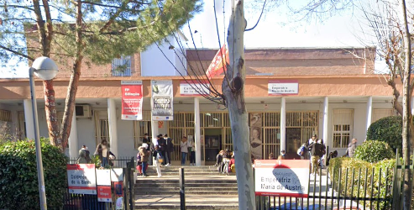
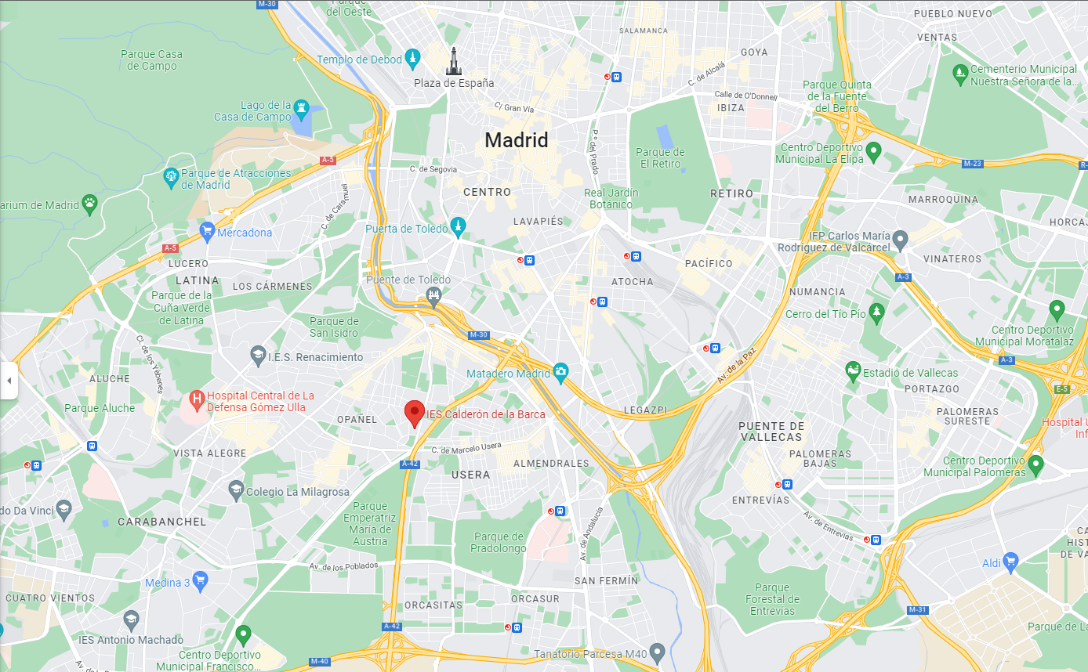
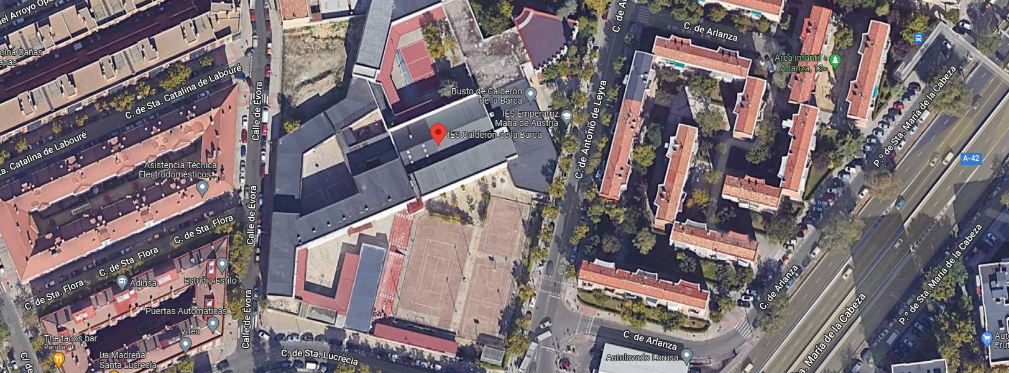
My high school
Where the school is:

Slide 2
GROUND FLOOR

Slide 3
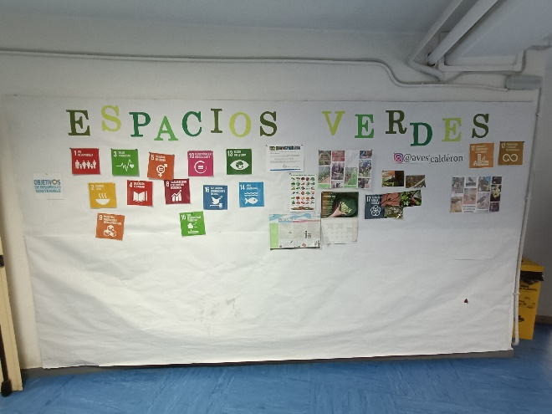
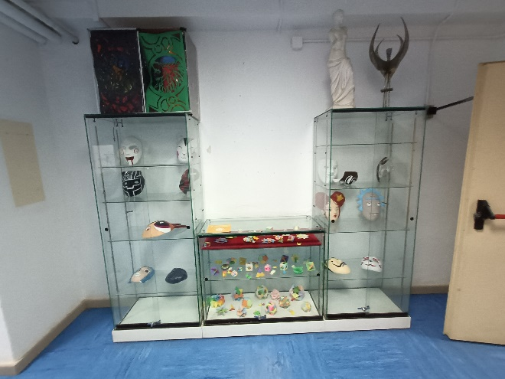
THE HALL
We enter here every morning, it is the main entrance of the building.

Slide 4
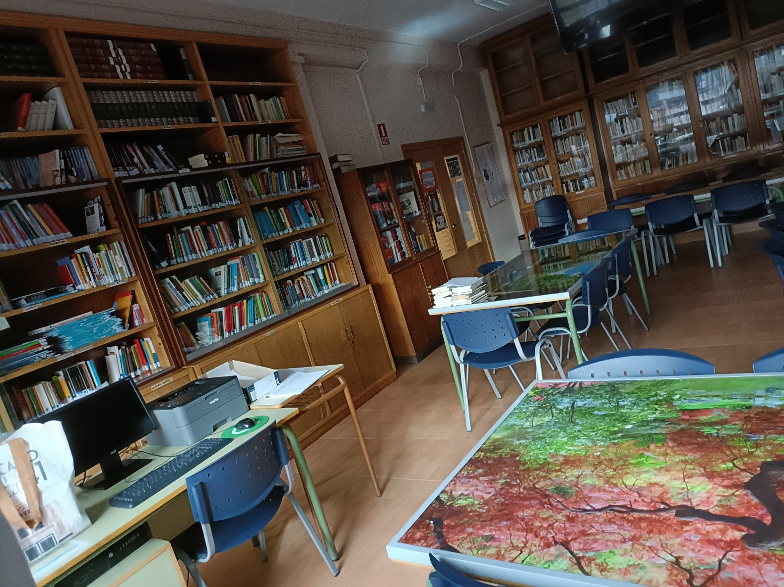
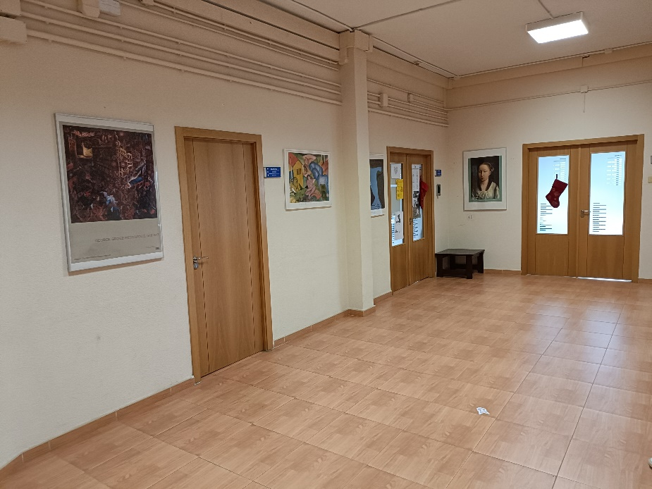
THE LIBRARY
In the library you can take books and CDs and in the playtime you can go here and do homework.

Slide 5
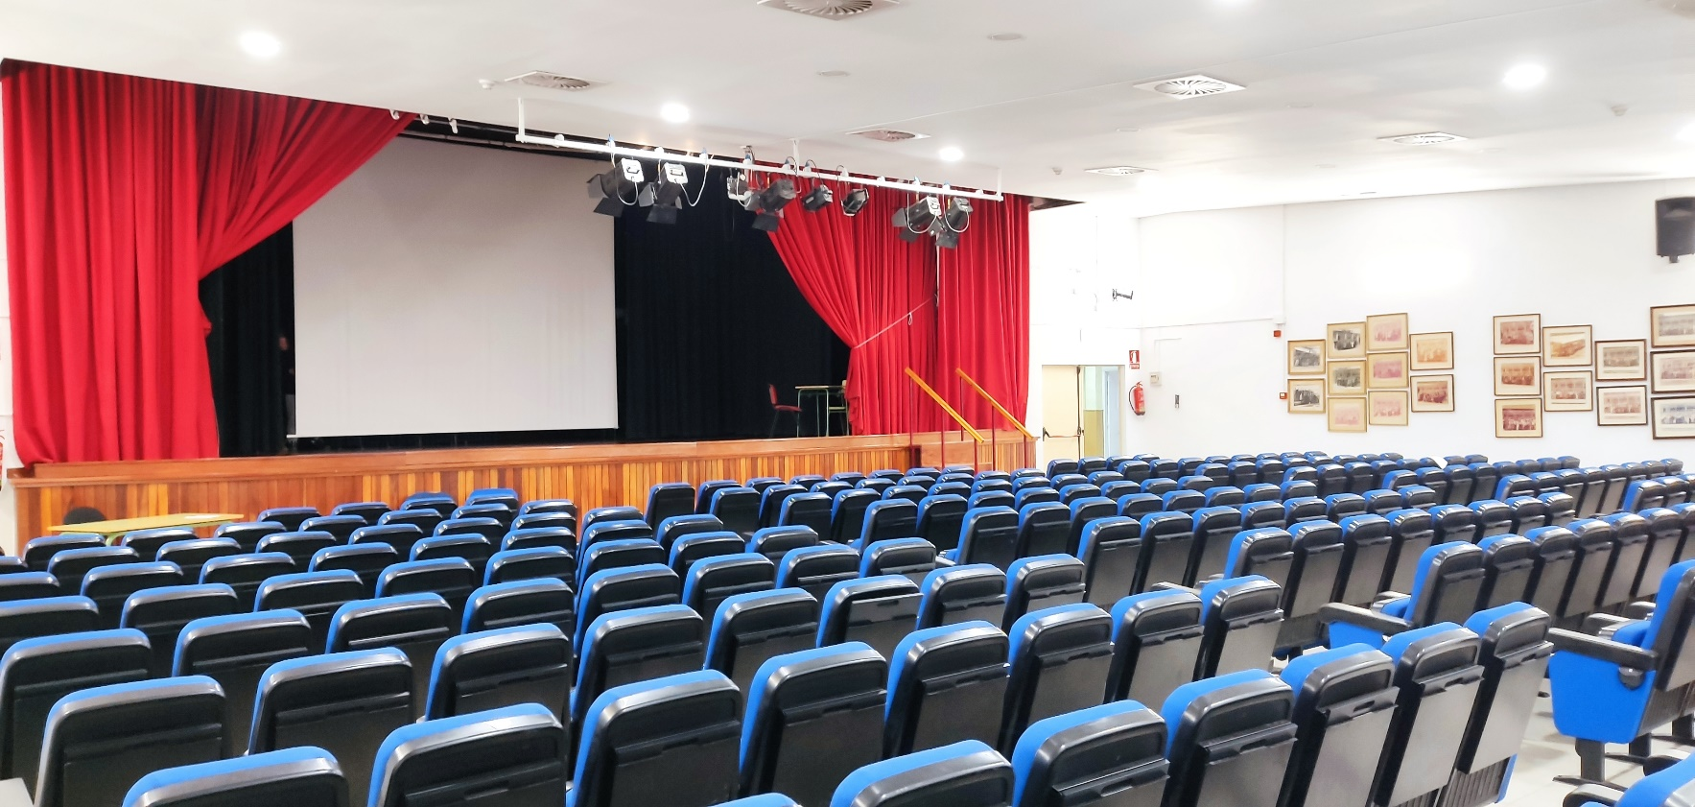
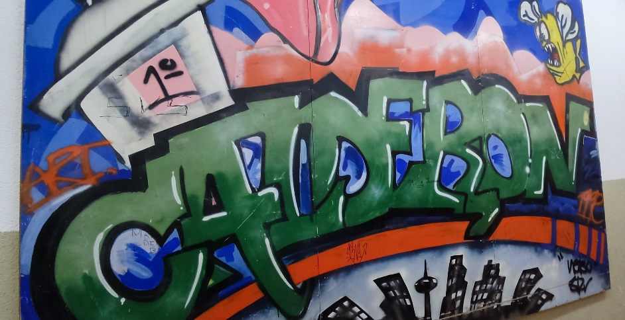
EVENTS ROOM
Here is where important events such as performances, presentations, and talks of diferents topics take place.

Slide 6
THE FLOORS

Slide 7
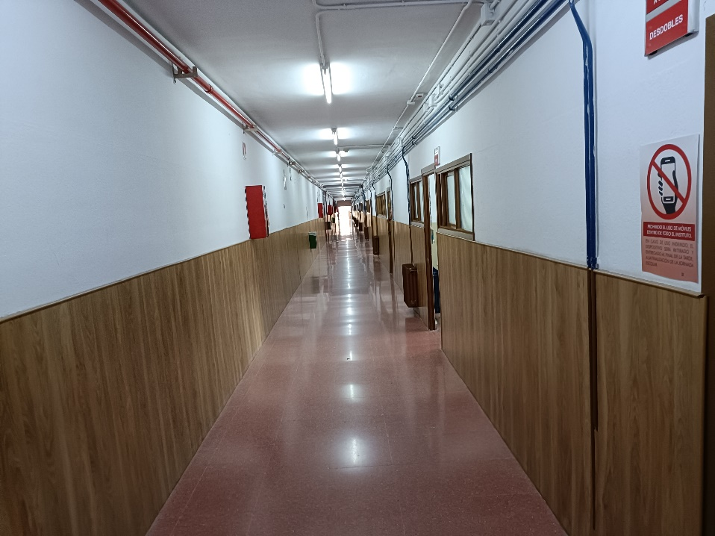
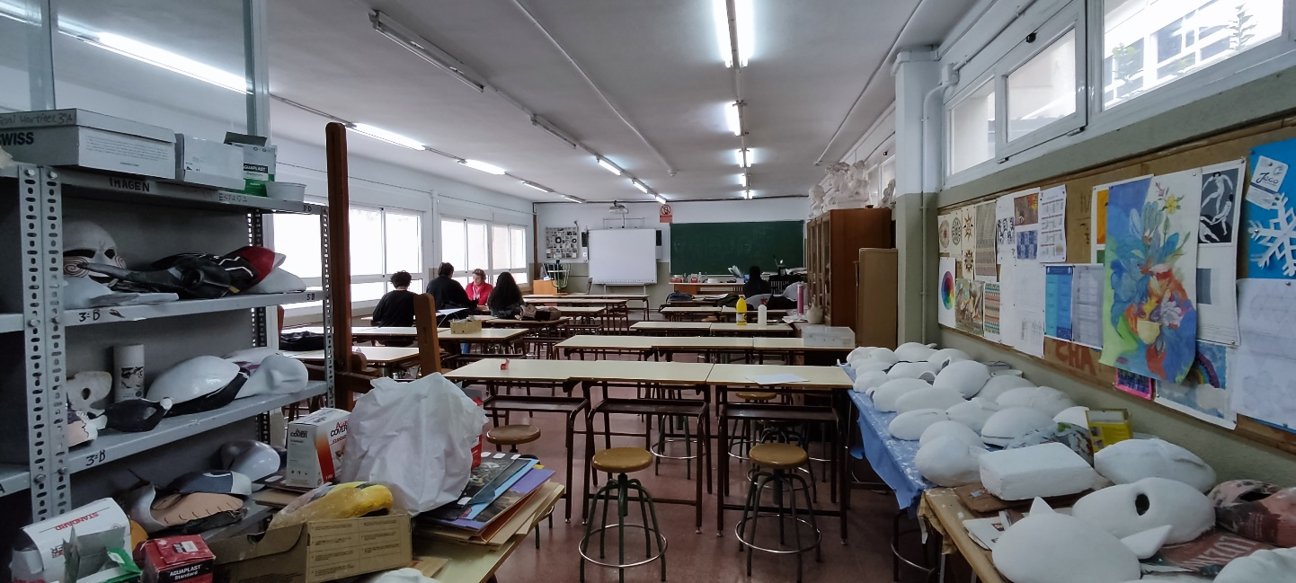
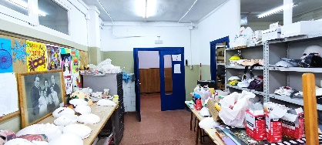
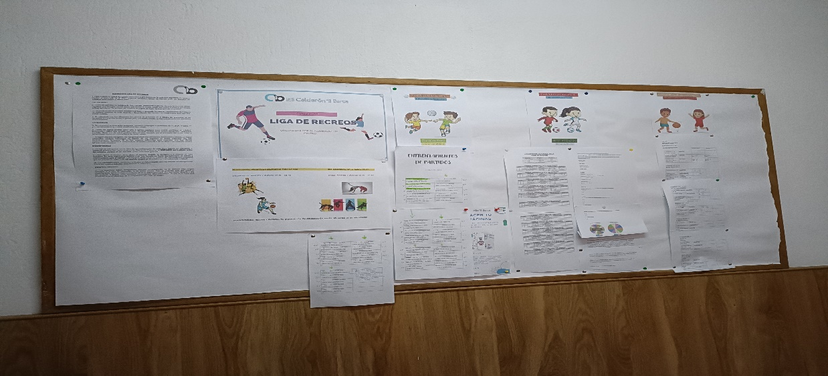
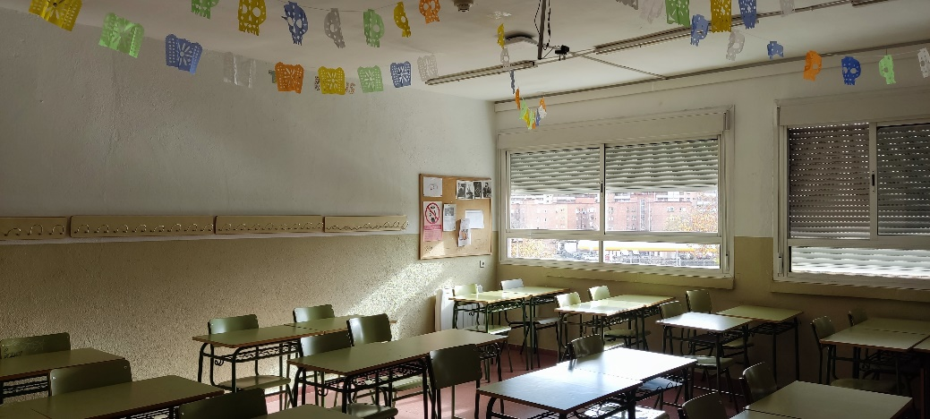
The corridors
Art classroom
Signboard
Normal classroom

Slide 8
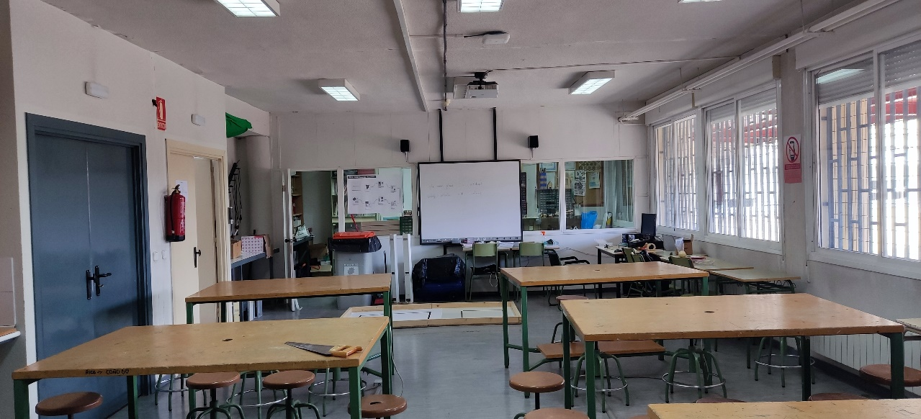
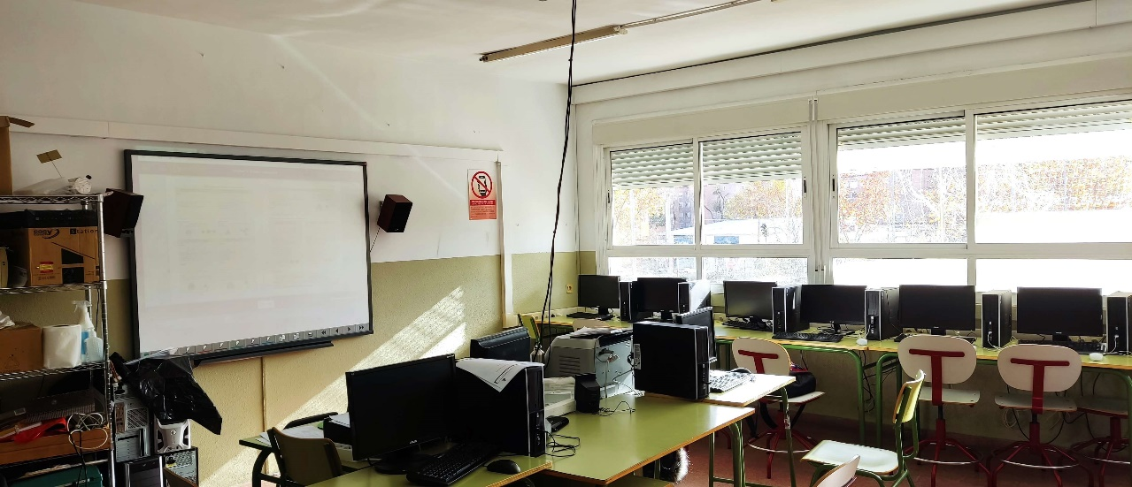
The tecnology classrooms
We have three classes, two for do informatic and the other one is for do things in the work room.

Slide 9
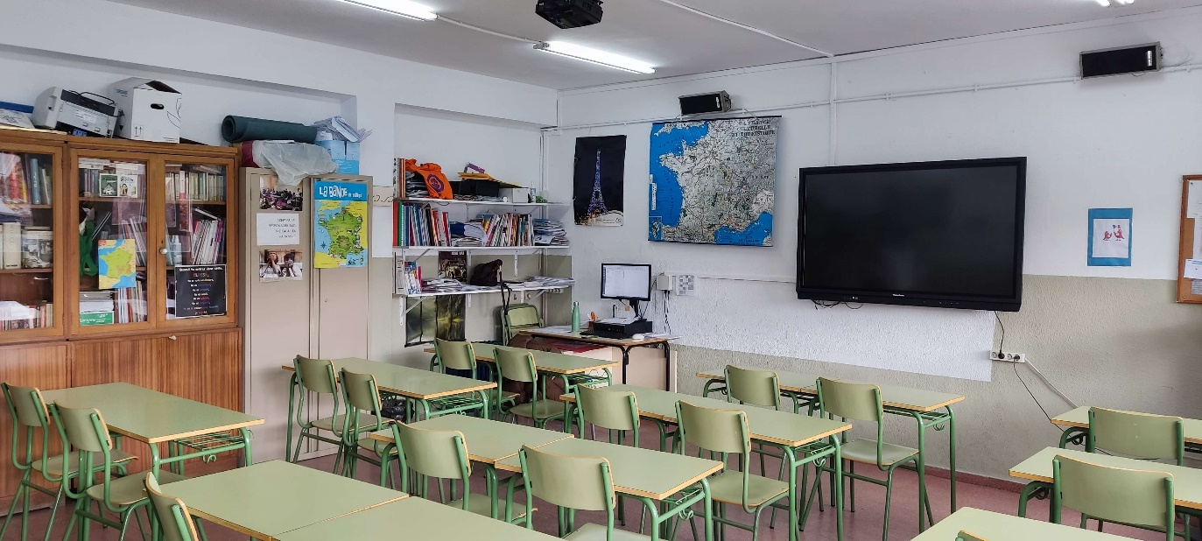
The biology classroom
French classroom
The french classes take place here
Here we usually do a lot of experiments using animal organs or microorganisms but we have lesson classes too.

Slide 10
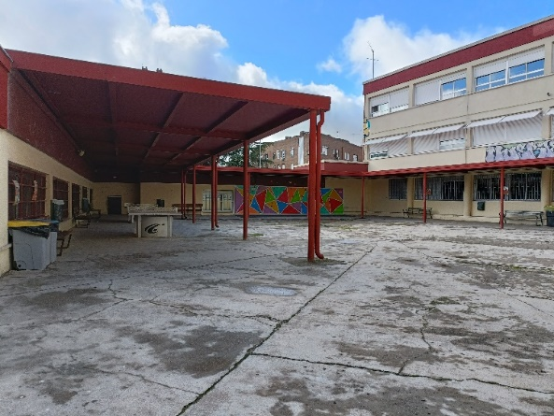
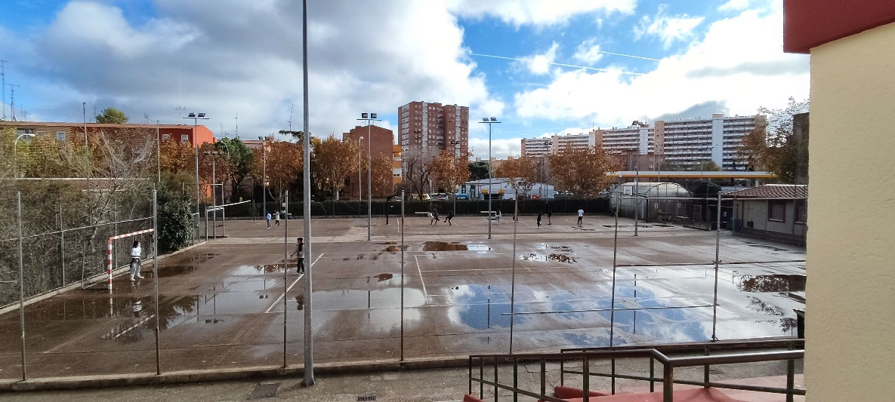
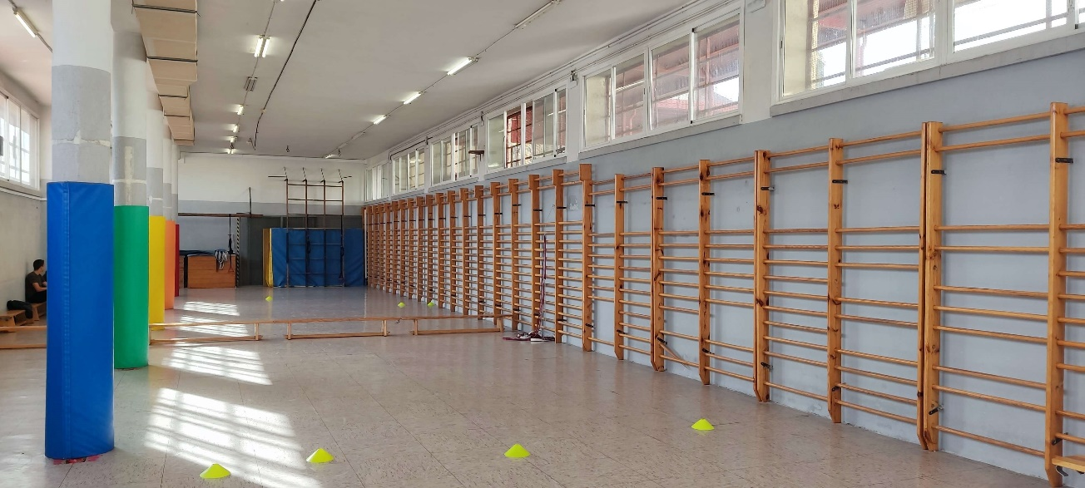
PLAYGROUND
This is our playground,it has two floors, one gym, and three pitches where we play basketball, football , voleyball... Each year we prepare basketball and football tournaments.

Slide 11
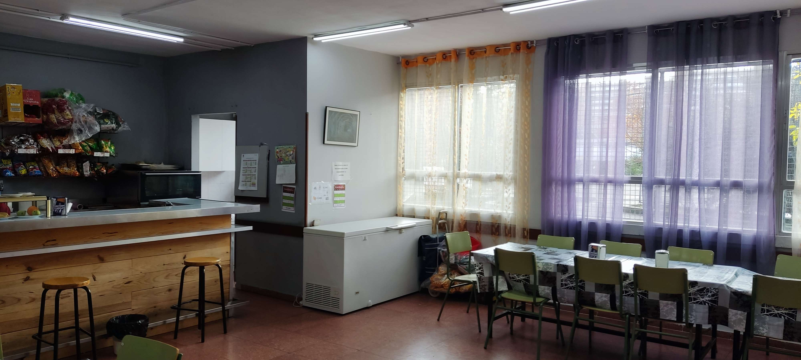
THE CAFÉ
This is the out part of the café
This is the inside part of the café , here we can buy some food and drinks for lunch in the playground time.

