Slide 1
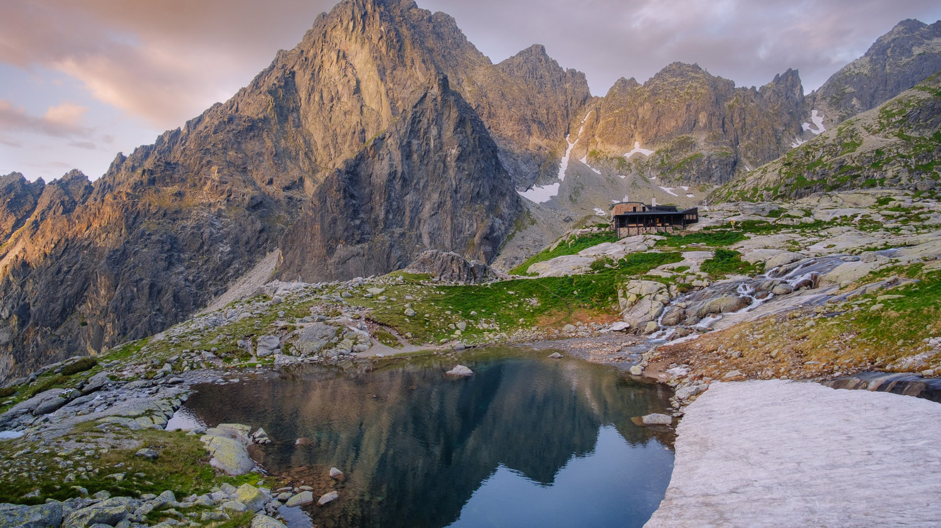
Slovakia

Slide 2
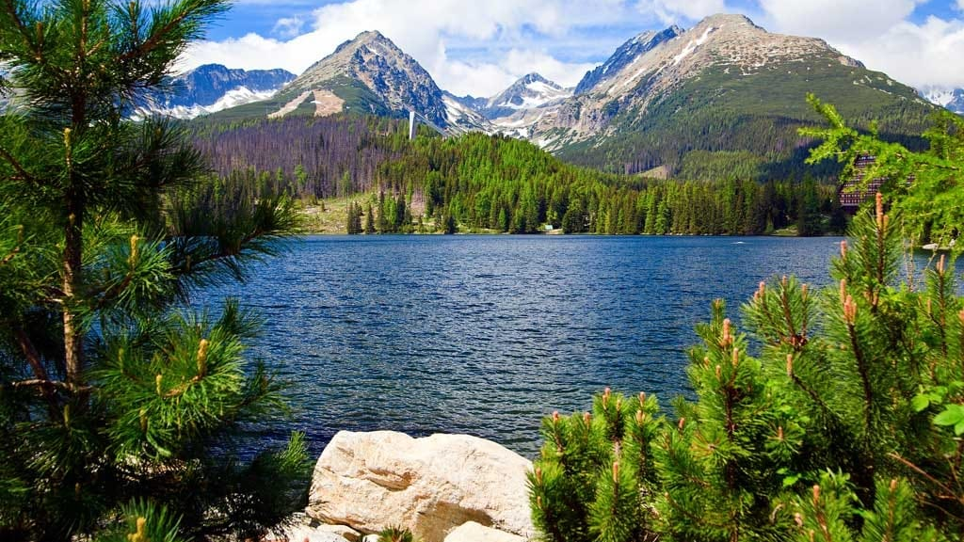
Most Recognisable Mountains
High Tatras

Slide 3
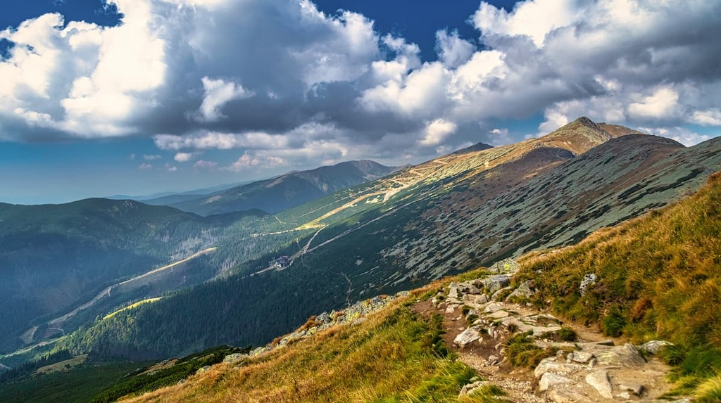
Most Recognisable Mountains
Low Tatras

Slide 4
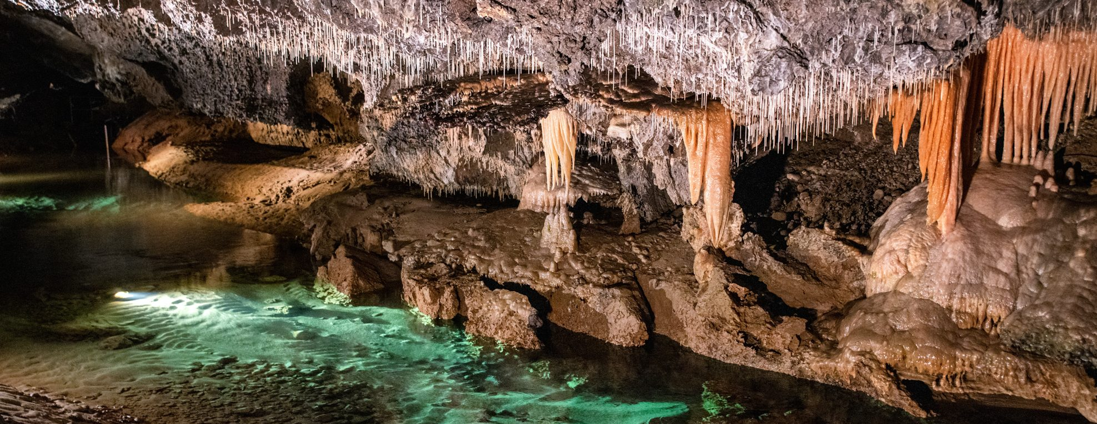
Caves You Should Visit
Demänovská Cave of Liberty

Slide 5
Dobšína Ice Cave

Slide 6
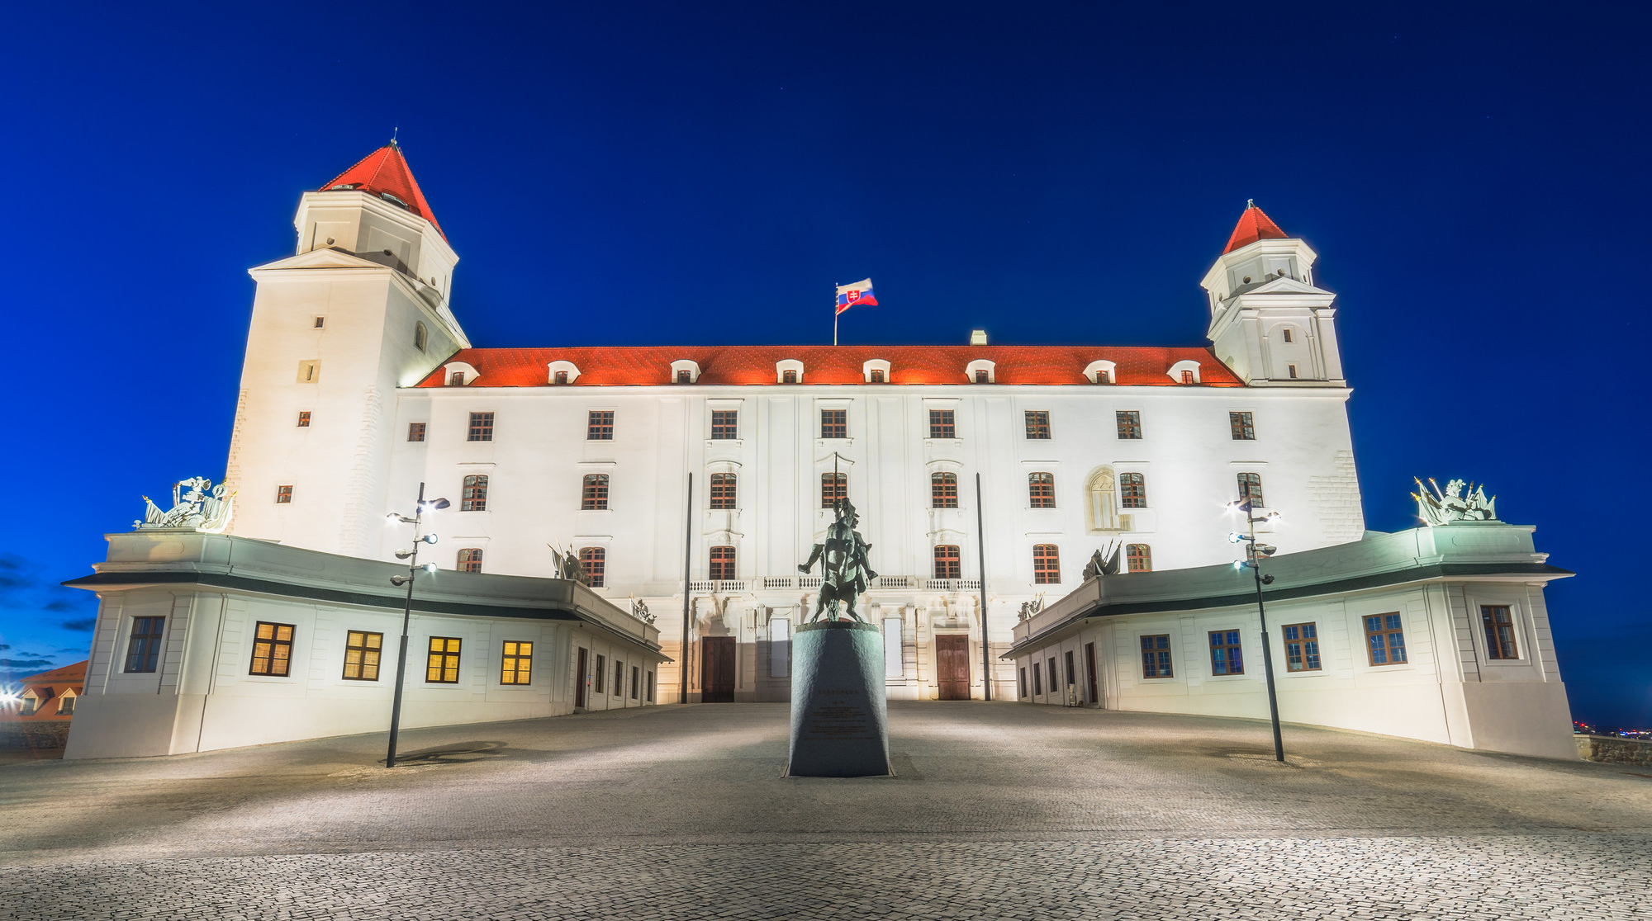
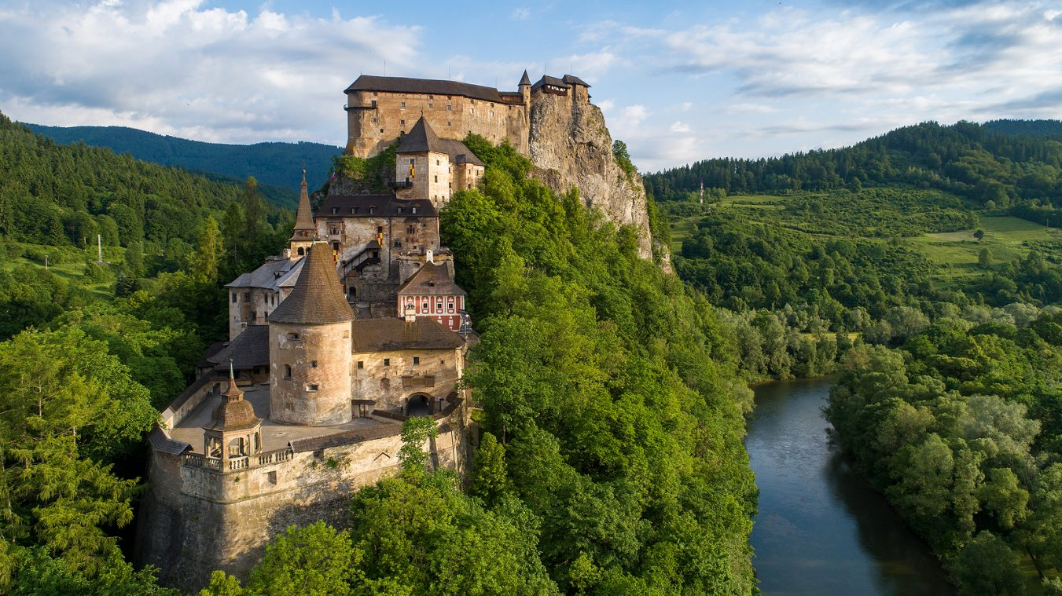
Castles you should visit
Bratislava castle
Orava Castle

Slide 7
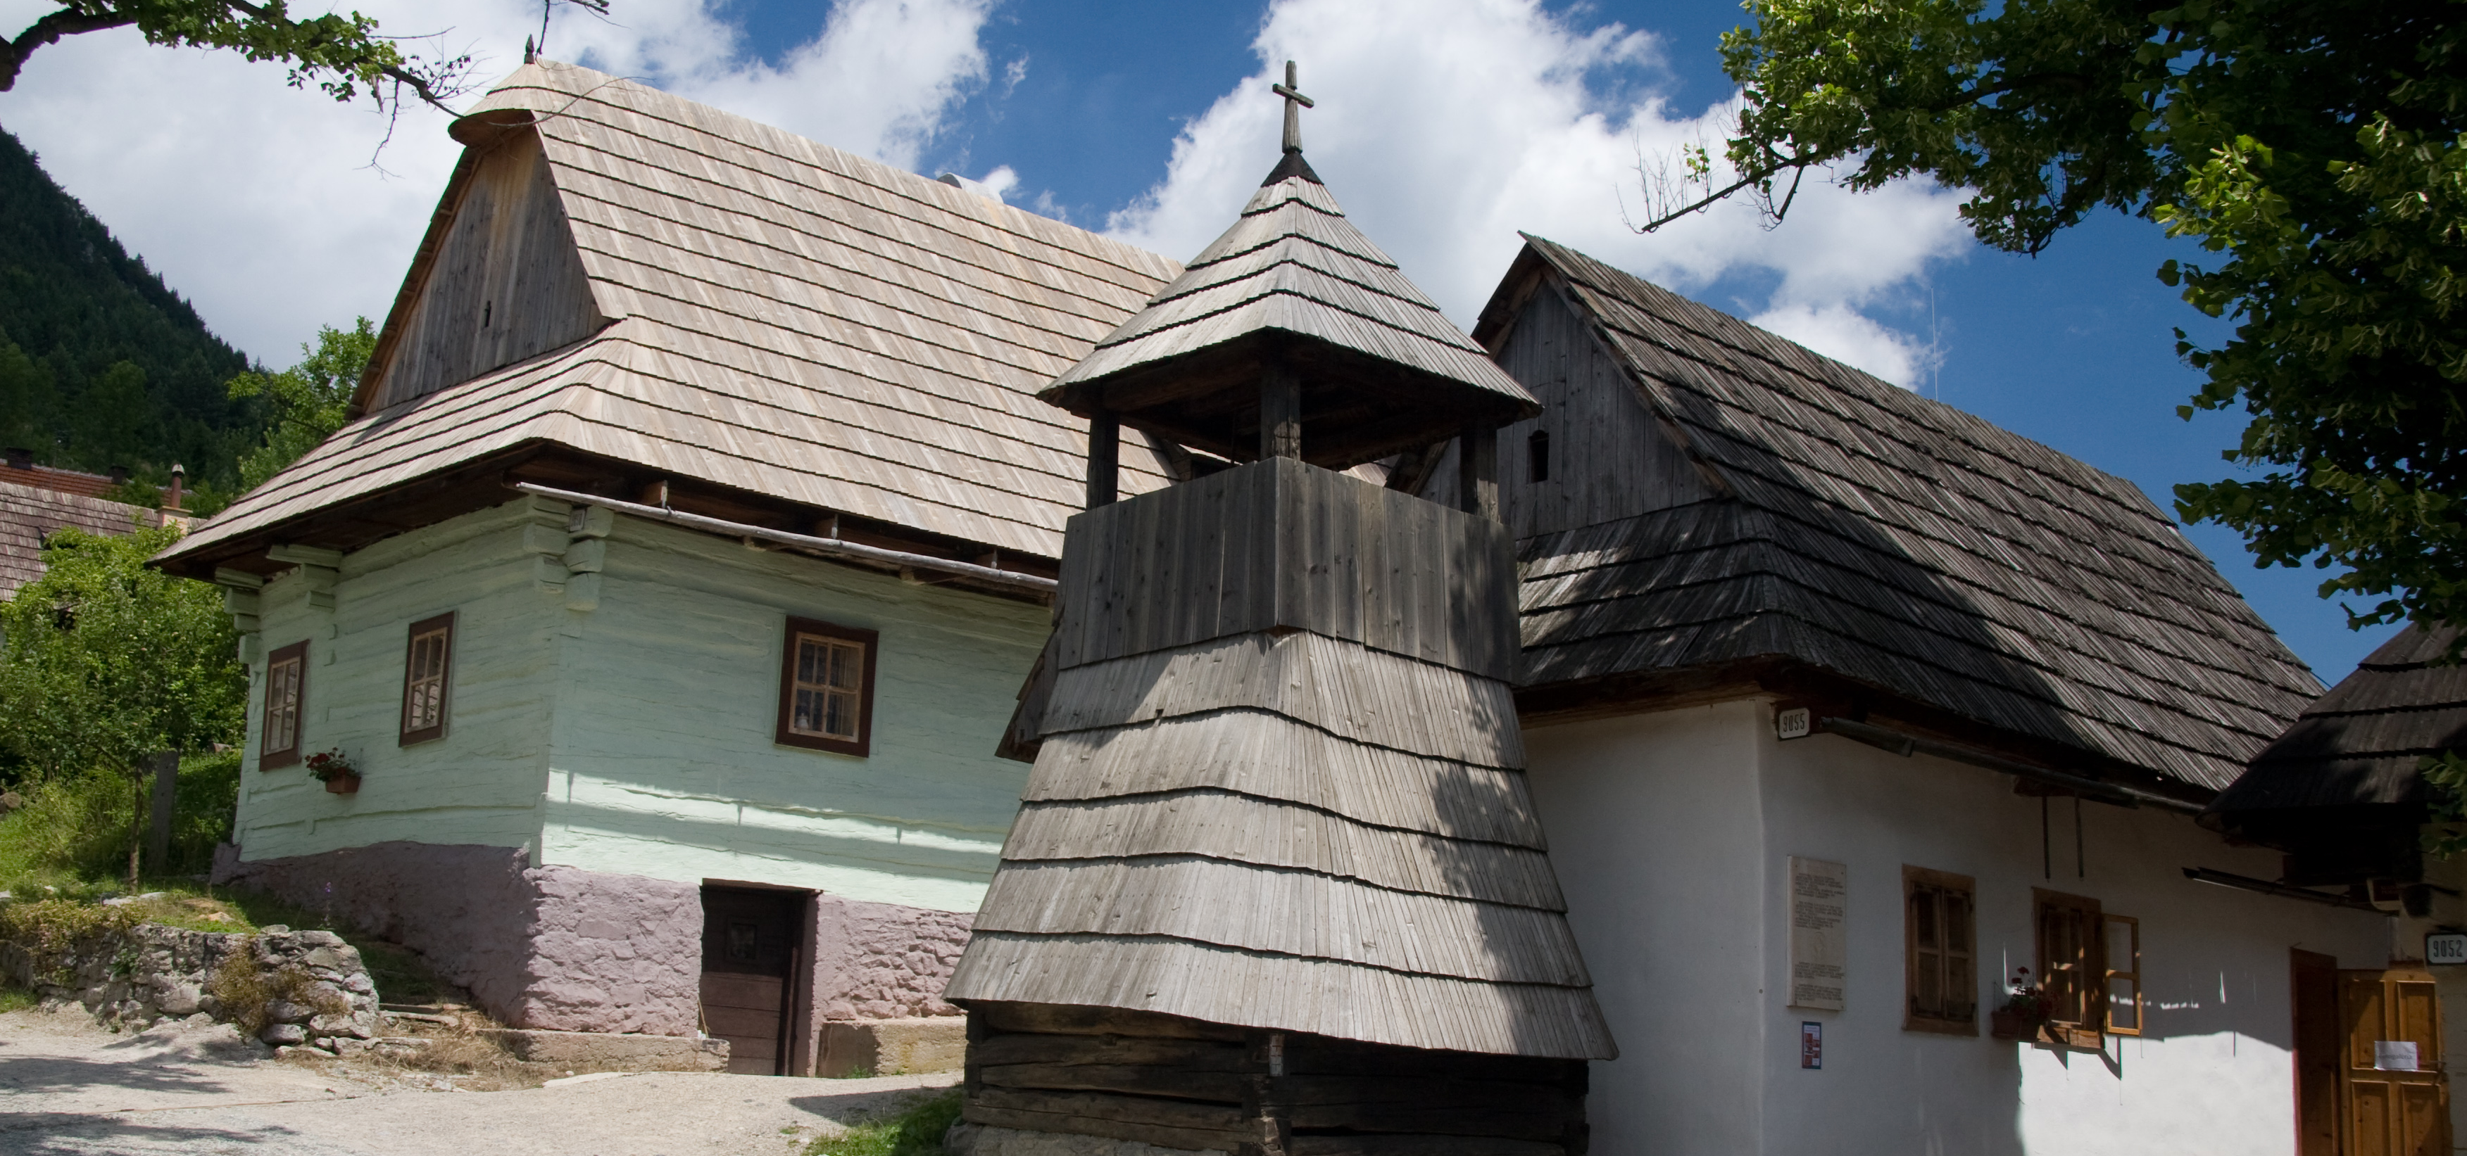
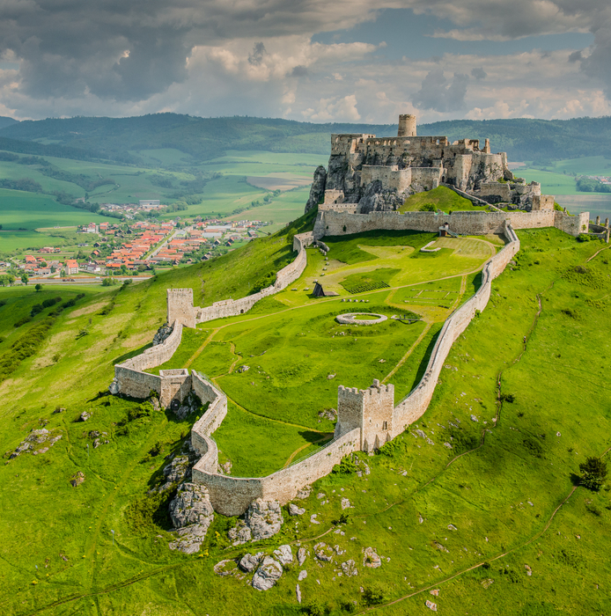
World Heritage Unesco
Spiš Castle
Vlkolinec

Slide 8
Important Personalities

Slide 9
Ľudovit Štúr
*1815
✞1856
Creation of Slovak language (1843)
Revolutioner (1848-1849)

Slide 10
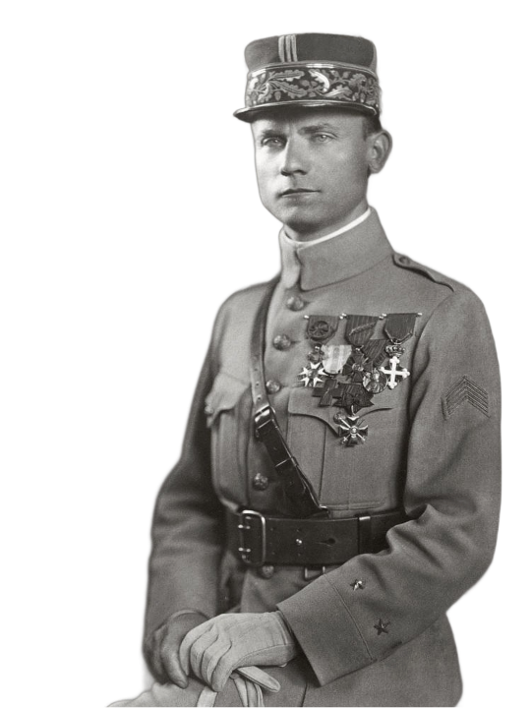
M.R. Štefánik
*1880
✞1919
General of French army
Pilot

Slide 11
Slovak Sport Representatives

Slide 12
Peter Sagan

Slide 13
Petra Vlhová

Slide 14
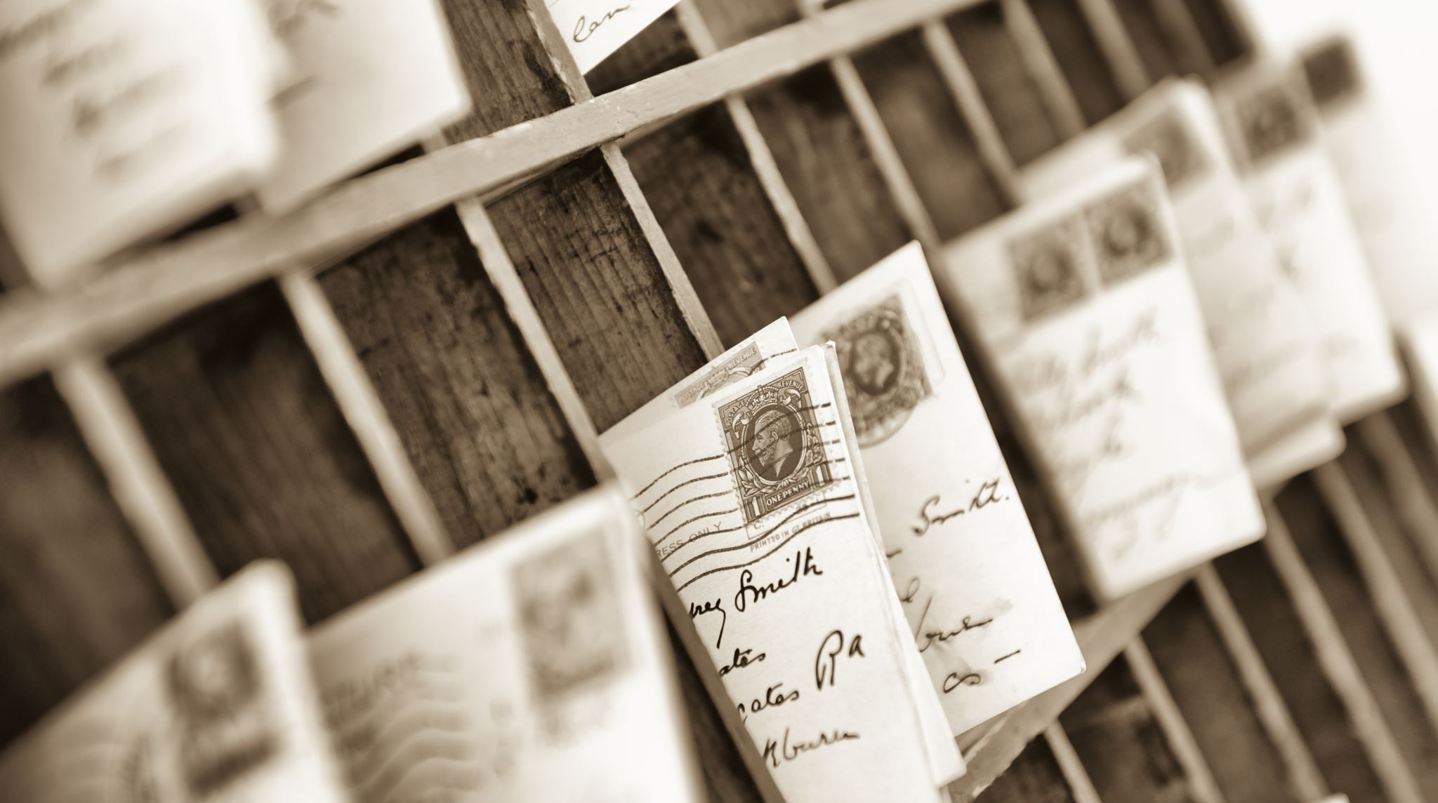
History

Slide 15
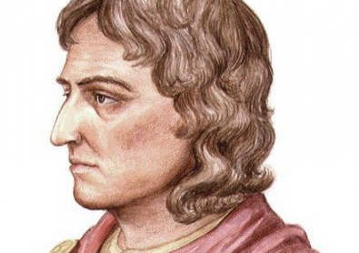
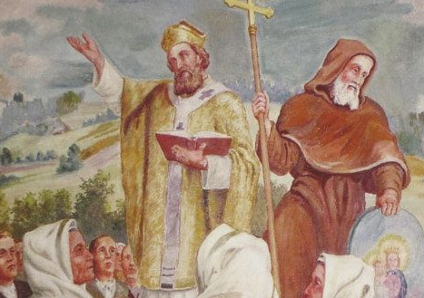
Great Moravia
830 – Unification of Slavic tribes under Mojmir I
846 -> 870 – Rule of Rastislav
863 – Arrival of Cyril and Methodius
- Cyril developed first Slavic alphabet
870 – Rastislav was overthrown by his nephew Svatopluk
871 -> 894 – Rule of Svatopluk
907 – Fall of Great Morava

Slide 16
Kingdom of Hungary and Austro-Hungarian Empire
1000 -> 1918 – Part of Hungary kingdom and Austro-Hungarian empire
1241 – Invasion of the Mongols
Medieval era – imigration of Jews and Germans
1465 – Foundation of university in Bratislava (Matthias Corvin)
1541 – Part of Austrian Habsburg monarchy
Dual monarchy

Slide 17
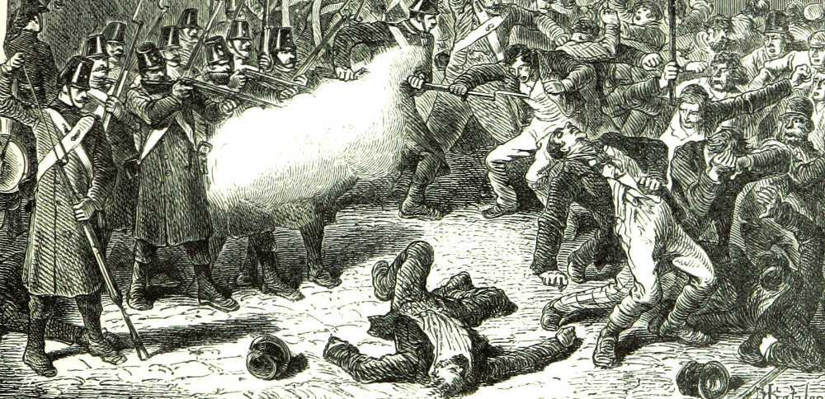
Revolution 1848-1849
Support from people of Slovakia to Austrian Emperor hoping for independence from Dual Monarchy
Basis of Slovak language

Slide 18
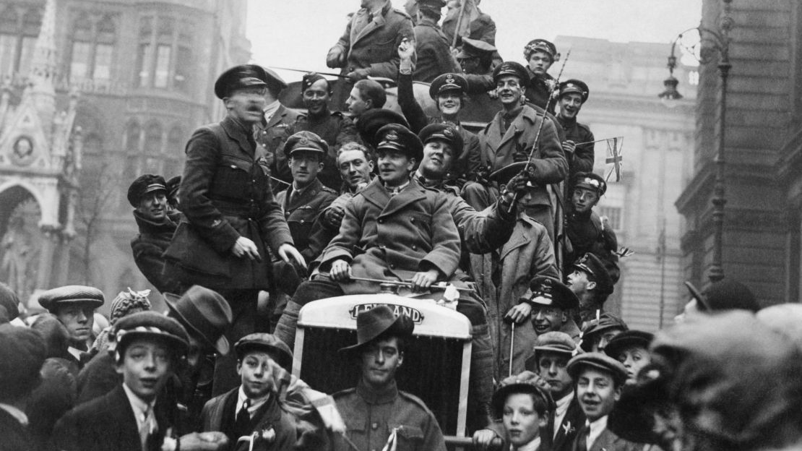
Post-WW1
Slovakia united with Czechia and created Czechoslovakia

Slide 19
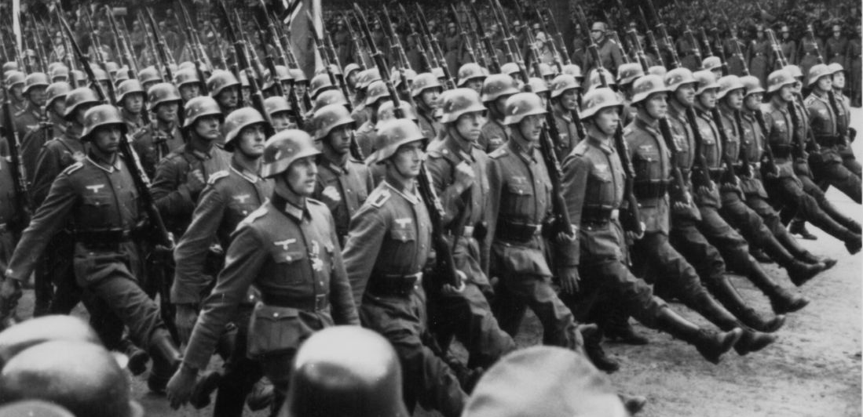
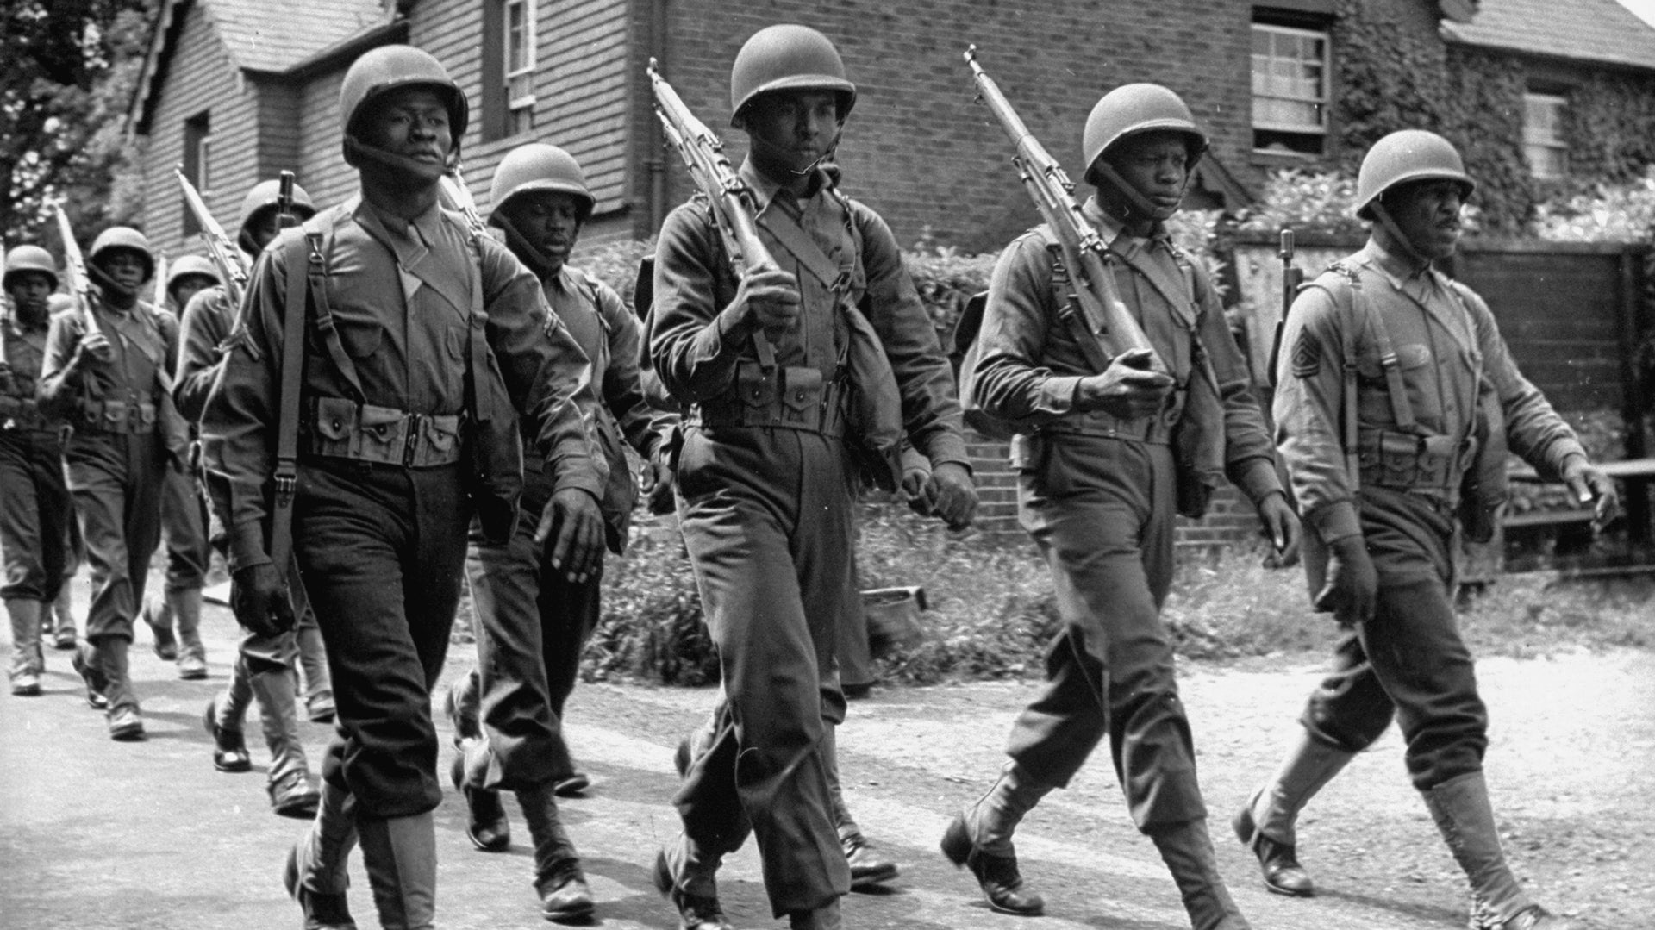
WW2 and Post-WW2
During WW2 Slovakia separated from Czechoslovakia and created first state form Slovak state
After WW2 Slovakia united with Czechia once more and established communism

Slide 20
1989-1992
Creation of modern Slovak Republic

Slide 21
Thanks for paying attantion
Viktoria Hodasová, Tamara Bellová, Michal Gut, Matej Behančín, Tomáš Dubovec

